Slide 1

ALEXIE DACOSTA

Slide 2
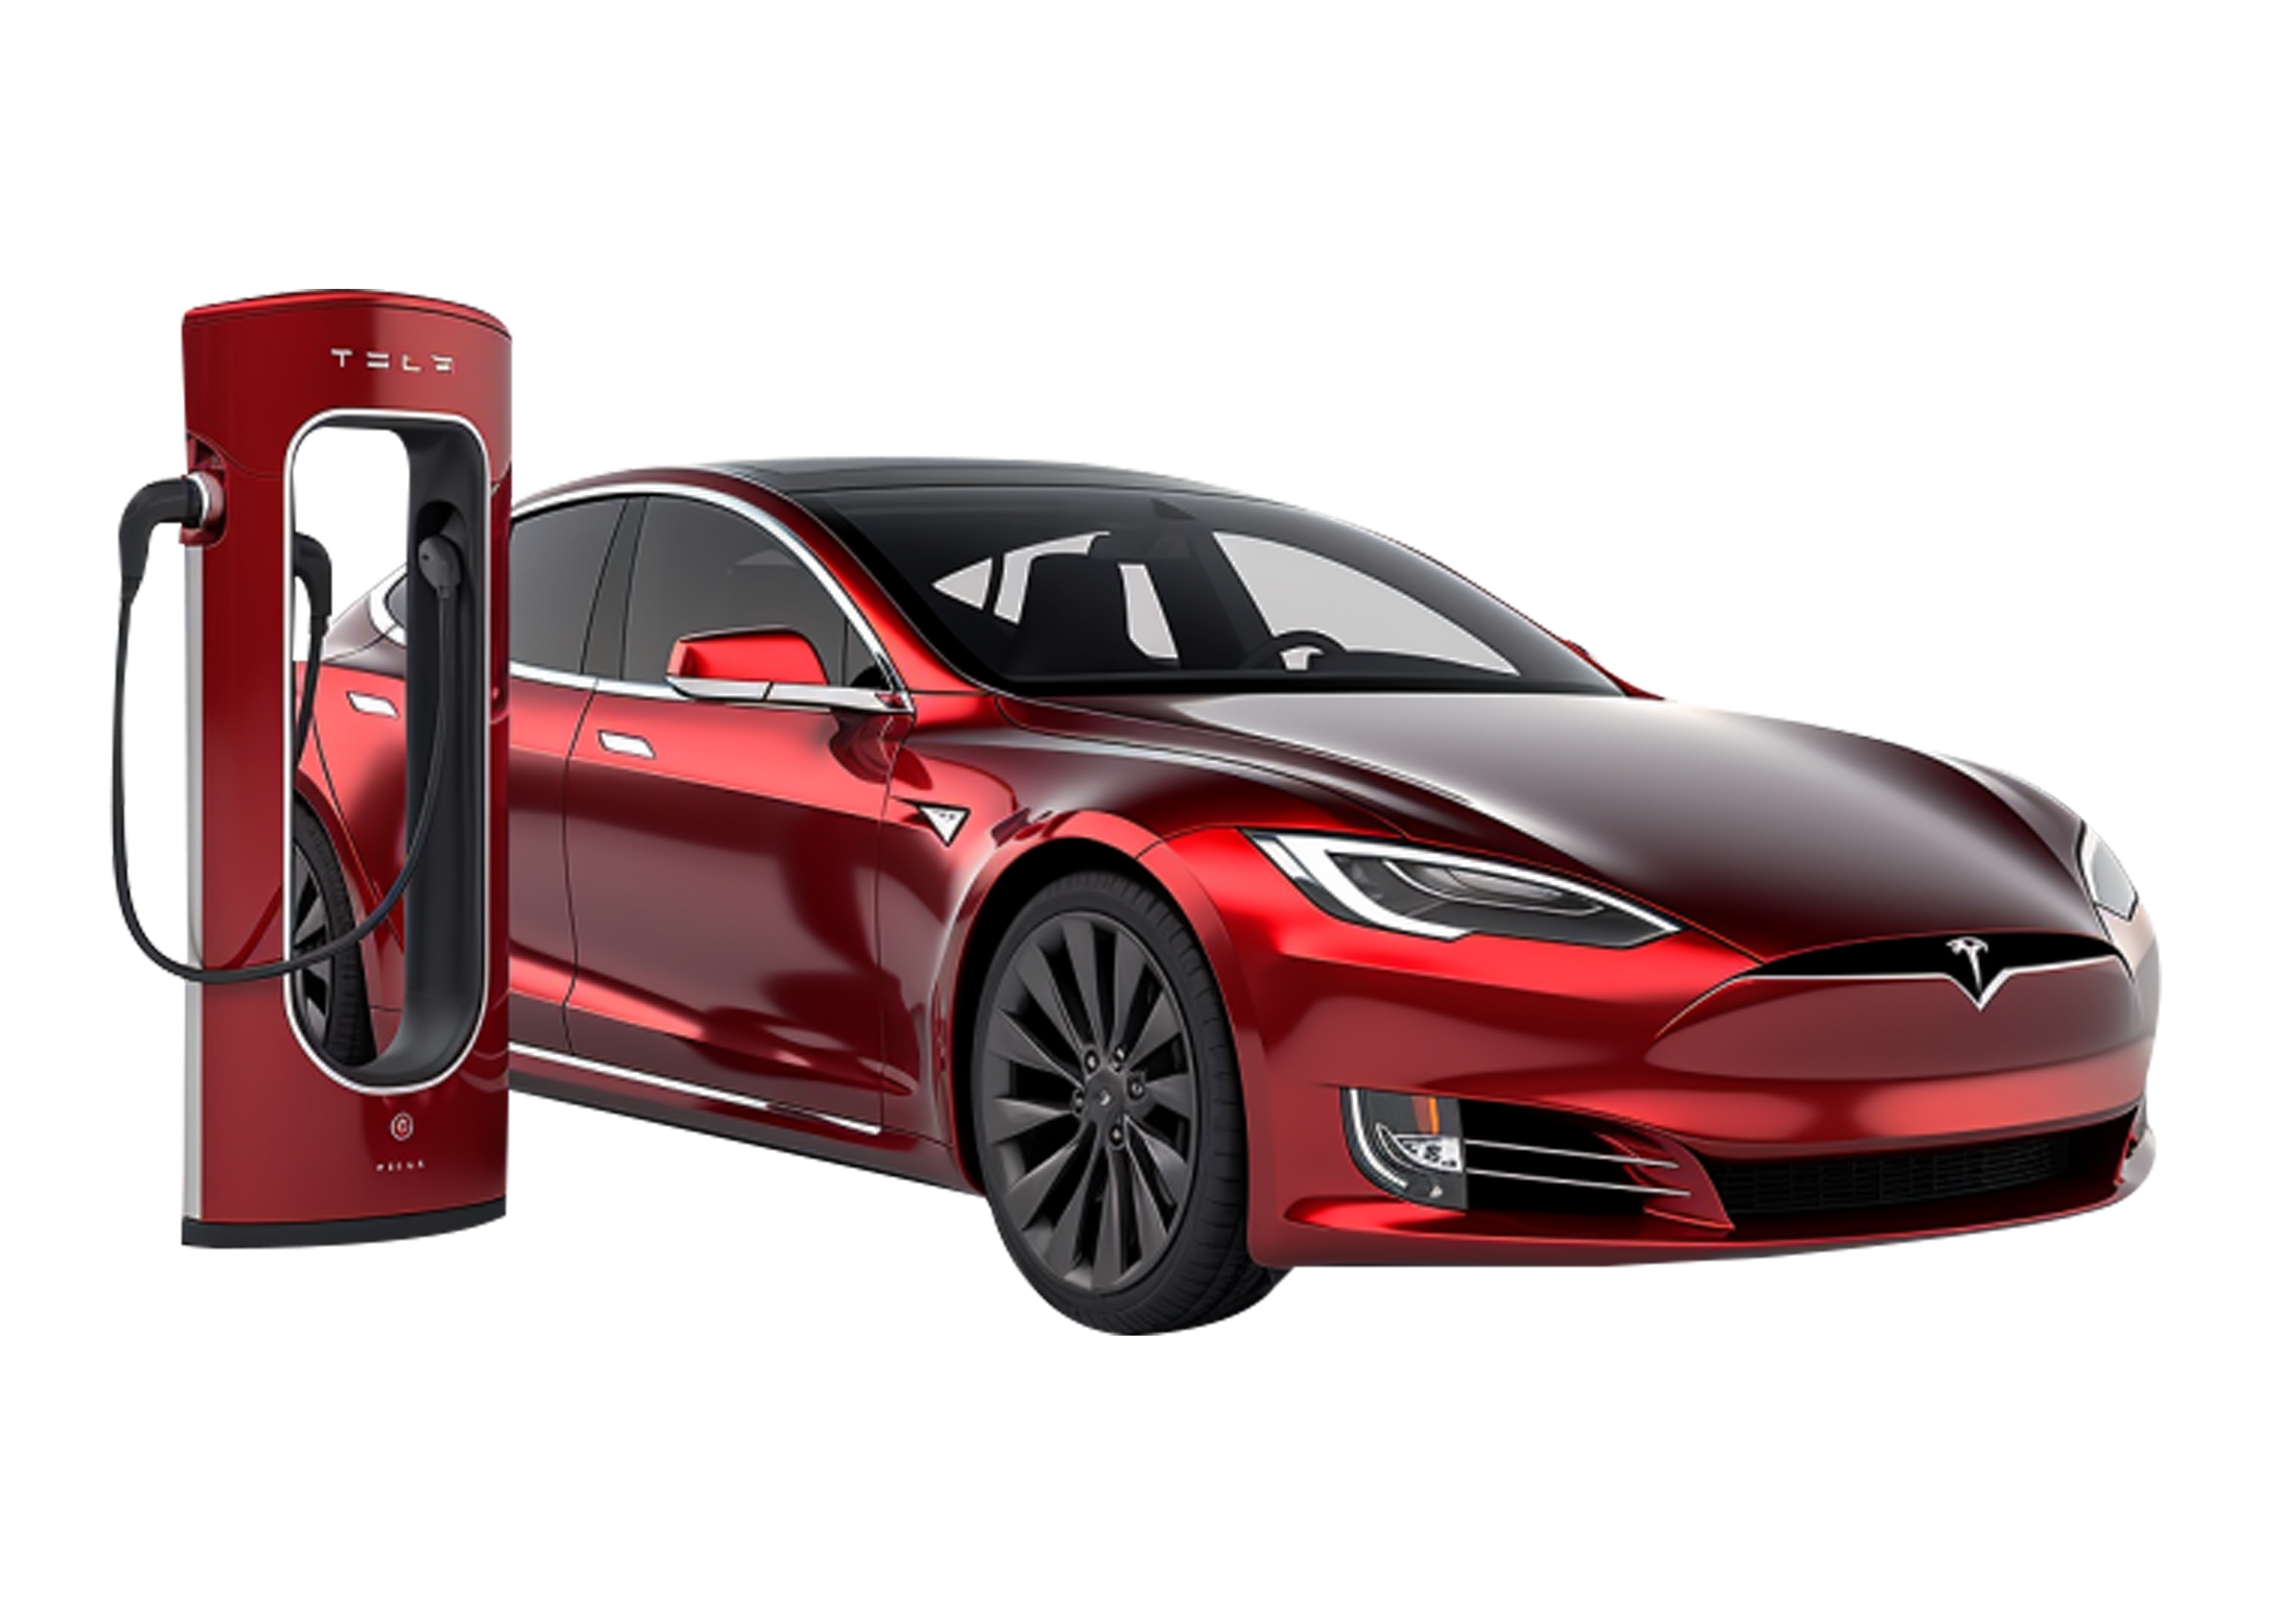
RESEARCH QUESTION
How do gasoline prices affect consumers’ interest in Tesla vehicles, and how might this relationship impact Tesla’s stock price?
Scope of the Project
Year 2024
United States of America

Slide 3
DATASETS
Tesla Stock (2024)
https://finance.yahoo.com/quote/TSLA/history/
Source: Yahoo Finance
Tesla Quarterly Sales Data (2024)
Q1 https://ir.tesla.com/press-release/tesla-vehicle-production-deliveries-and-date-financial-results-webcast-first-quarter-2024
Q2 https://ir.tesla.com/press-release/tesla-vehicle-production-deliveries-and-date-financial-results-webcast-second-quarter-2024
Q3 https://ir.tesla.com/press-release/tesla-third-quarter-2024-production-deliveries-and-deployments
Q4 https://ir.tesla.com/press-release/tesla-fourth-quarter-2024-production-deliveries-and-deployments
Source: Tesla’s Investors Relations
Google Trends Data on the Keyword ‘Tesla’ in the United States (2024)
https://trends.google.com/trends/
Source: Google Trends
U.S. Gasoline Prices
https://www.eia.gov/petroleum/gasdiesel/
Source: U.S. Energy Information Administrations (E.I.A)

Slide 4


Slide 5
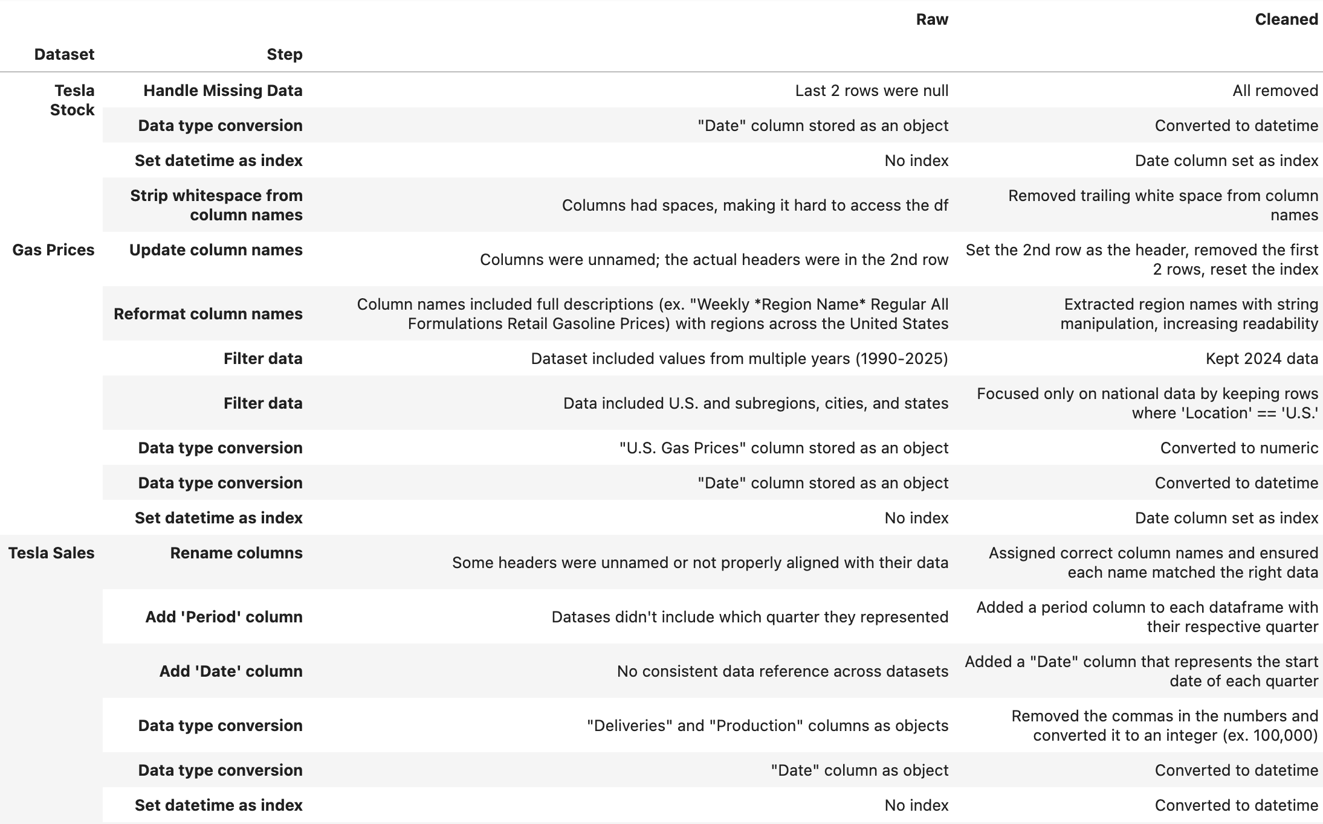
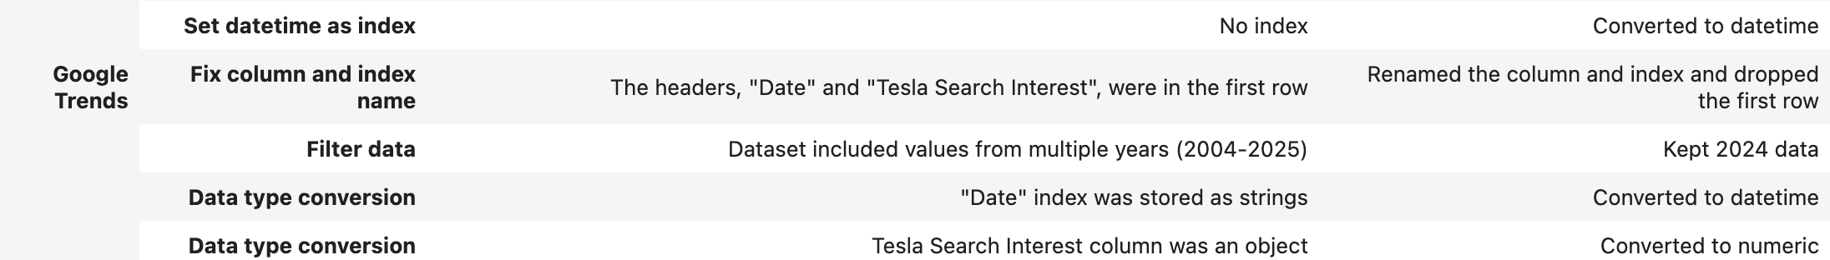
DATA CLEANING

Slide 6
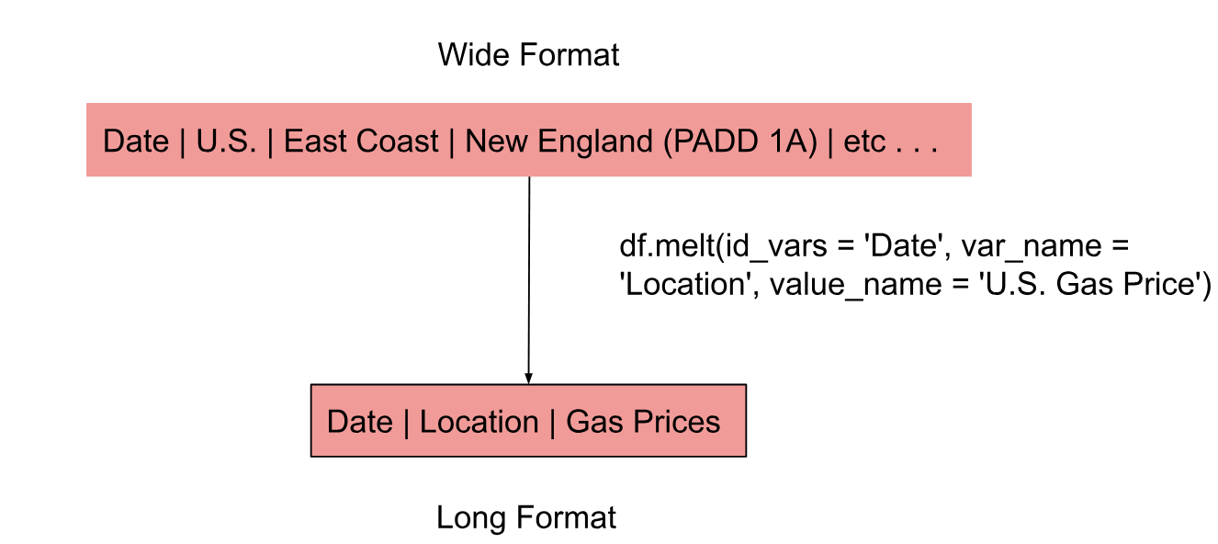
DATA WRANGLING: Melt U.S. Gasoline Prices

Slide 7

DATA WRANGLING: Concatenate Tesla Quarterly Sales Data
Tesla Sales
Q1
Q2
Q3
Q4

Slide 8
DATA WRANGLING: Join All Datasets
Google Trends
Tesla Sales
Tesla Stock
U.S. Gasoline Prices
DATETIME INDEX

Slide 9


Slide 10
Do Higher Gas Prices Drive Tesla Curiosity?
Insight
The positive correlation between gas prices and Google search interest in Tesla suggests that rising fuel costs may increase consumer curiosity in Tesla vehicles. This trends highlights a potential shift in consumer behavior as gas becomes more expensive.

Slide 11
Tesla’s Sales Climb Despite Lower Gas Prices
This subplot compares gas prices throughout 2024 with Tesla’s quarterly sales. While gas prices fluctuate—spiking in April before trending downward–Tesla’s sales consistently increase each quarter. Although high gas prices may trigger consumers to research Tesla, gas prices do not directly impact sales.

Slide 12
Sales Are the Bridge Between Curiosity and Market Value
Insight
This correlation matrix reveals a potential chain of influence. Google search interest strongly correlates with Tesla’s sales (r = 0.81), and sales strongly correlate with Tesla’s stock price (r = 0.76). This heatmap suggests that consumer curiosity may lead to more purchases, which then drive investor’s confidence and stock performance.

Slide 13
Tesla’s Climb Following the April Gas Price Spike: A Delayed Reaction?
Insight
This dual y-axis graph compares U.S. gas prices with Tesla’s stock price over time. Gas prices have a noticeable spike in April. In contrast, Tesla’s stock price experiences a significant spike approximately six months later. While there is no immediate correlation between the two variables, the delayed increase in Tesla’s stock may suggest a lagging consumer response—potentially as individuals begin researching and transitioning to electric vehicles in reaction to elevated fuel costs.

Slide 14
SUMMARY OF
FINDINGS
The data suggests that gasoline prices influence consumer interest in Tesla vehicles, as seen through a strong correlation between gas prices and Google search trends. This increased interest appears to translate into higher sales, which are strongly linked to Tesla’s stock performance.
Results
While higher gas prices do not directly impact Tesla’s stock, they may initiate a chain of events—sparking curiosity in consumers to research Tesla vehicles, leading to purchases, and ultimately contributing to Tesla’s stock growth.

Slide 16



